Slide 1
Introduction to Multivariable Calculus
Exploring the Dimensions Beyond

Slide 2
What is Multivariable Calculus?
Multivariable calculus, also known as multivariate calculus, involves the extension of calculus to functions of multiple variables
It's an essential branch of mathematics for understanding changes in a multidimensional space

Slide 3
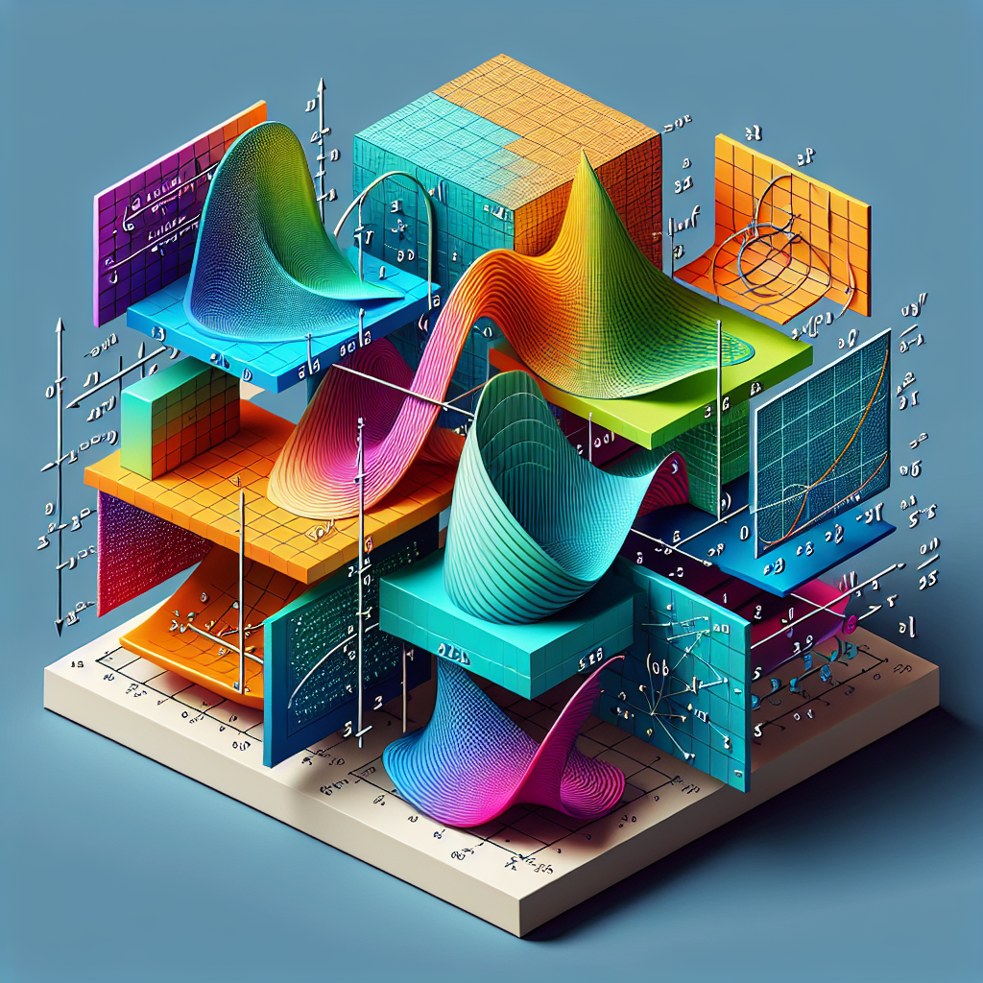
Visualizing Graphs in 3D
In multivariable calculus, visual representation includes 3D graphs that illustrate complex relationships between variables
Three-Dimensional Graph

Slide 4
Partial Derivatives
Partial derivatives measure the rate of change of a function as it relates to variables maintaining the others constant
They offer insights into the function's sensitivity to changes in any one of the multiple variables

Slide 5

Applications of Multivariable Calculus
This field of mathematics is pivotal in areas like physics, engineering, and economics, helping to model and solve real-world problems involving multiple variables and dimensions
Applications in Various Fields

Slide 6
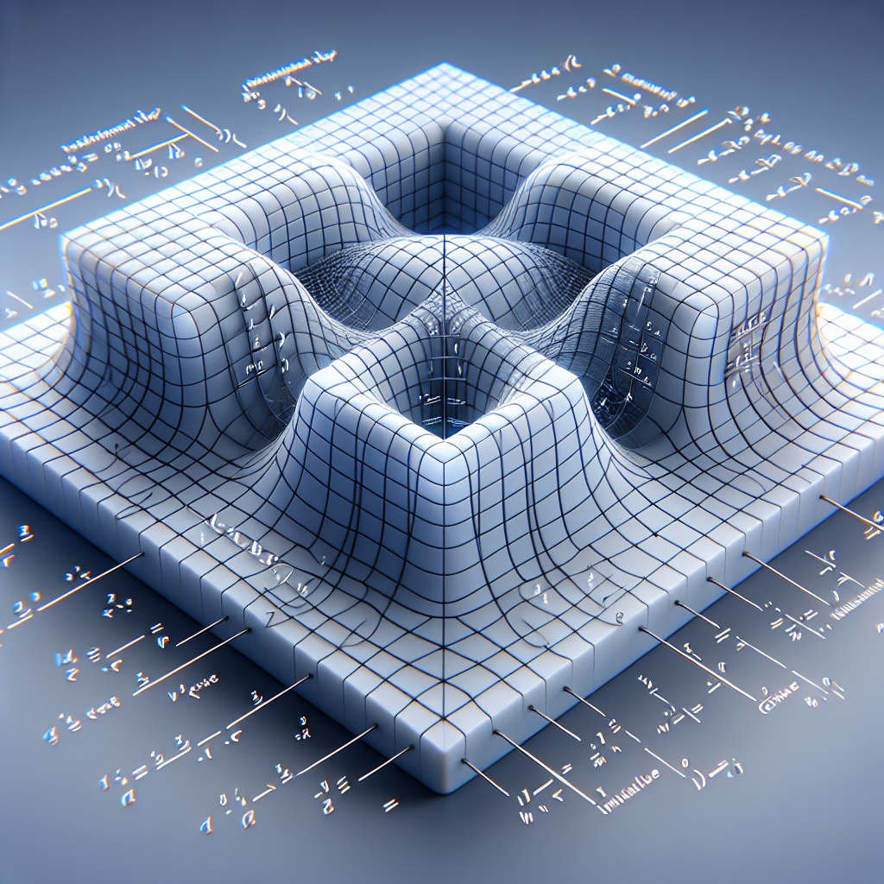
Multiple Integrals
Multiple integrals extend the idea of integration to functions of several variables, often used to calculate volumes under surfaces in the multidimensional space
Calculating Volume

Slide 7
Differential Equations in Multivariable Calculus
Many physical laws and phenomena are modeled by differential equations involving functions of multiple variables
Solving these requires techniques from multivariable calculus

Slide 8
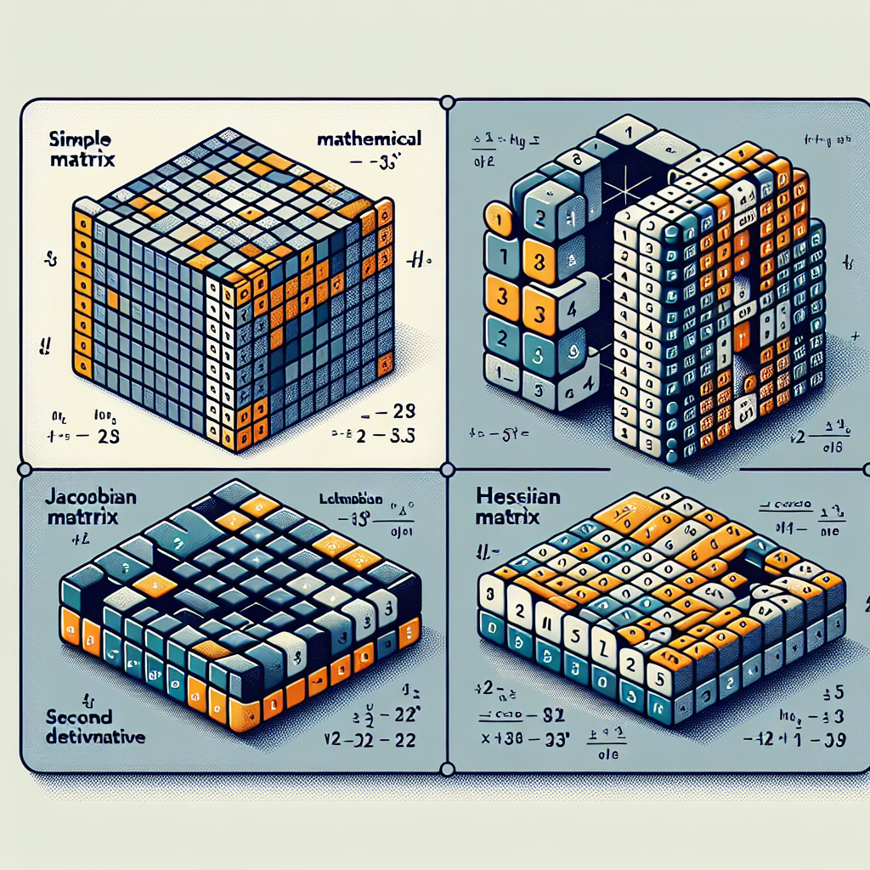
Jacobian and Hessian Matrices
The Jacobian and Hessian matrices are powerful tools used for examining the rate of change and the convexity of functions respectively, in multivariable calculus
Matrices in Multivariable Calculus

Slide 9
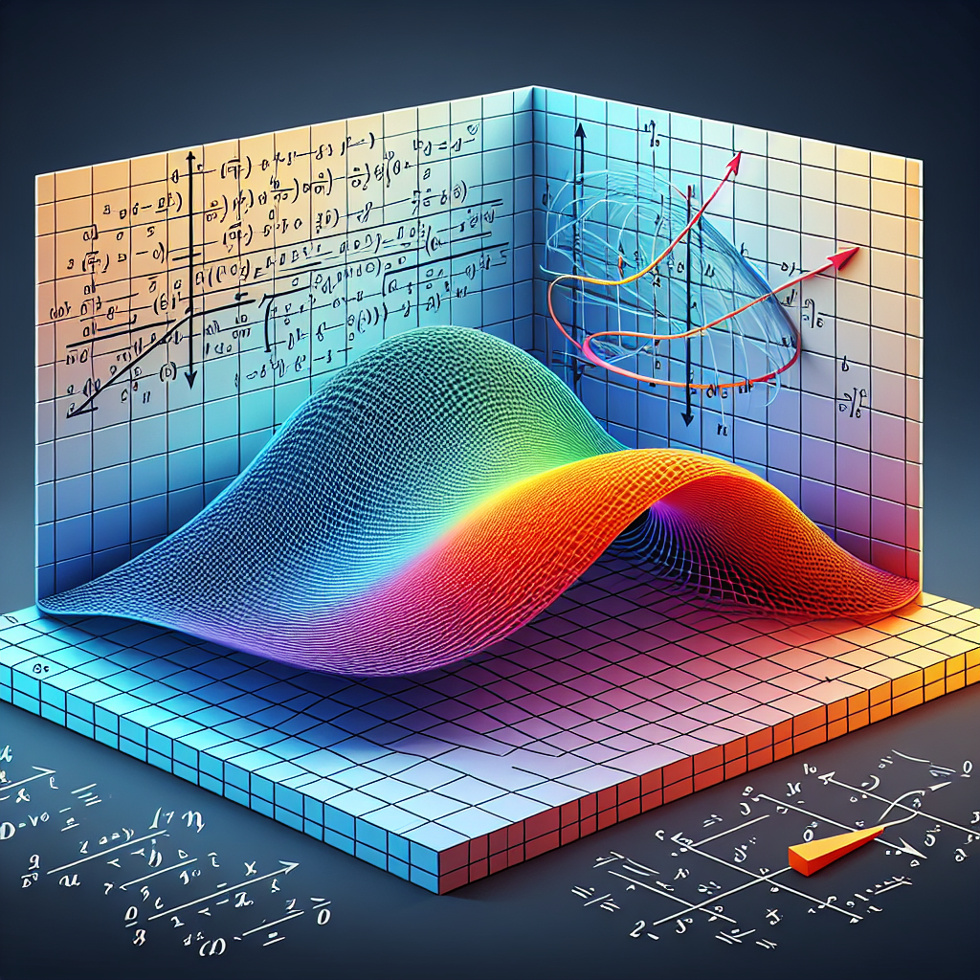
Gradient Vectors and Directional Derivatives
Gradient vectors represent the direction and rate of fastest increase of a function, whereas directional derivatives measure the rate of change of the function in any direction
Understanding Gradient Vectors

Slide 10
Theorems of Multivariable Calculus
Key theorems like Green's, Stokes', and the Divergence theorem play crucial roles in connecting multivariable calculus concepts to physical interpretations
They establish important relationships and principles in the study of vector fields and flux

Slide 11

Optimization in Multivariable Calculus
Multivariable calculus provides techniques for finding maximum and minimum values of functions, critical in areas like machine learning, economics, and engineering design
Optimization Techniques

Slide 12
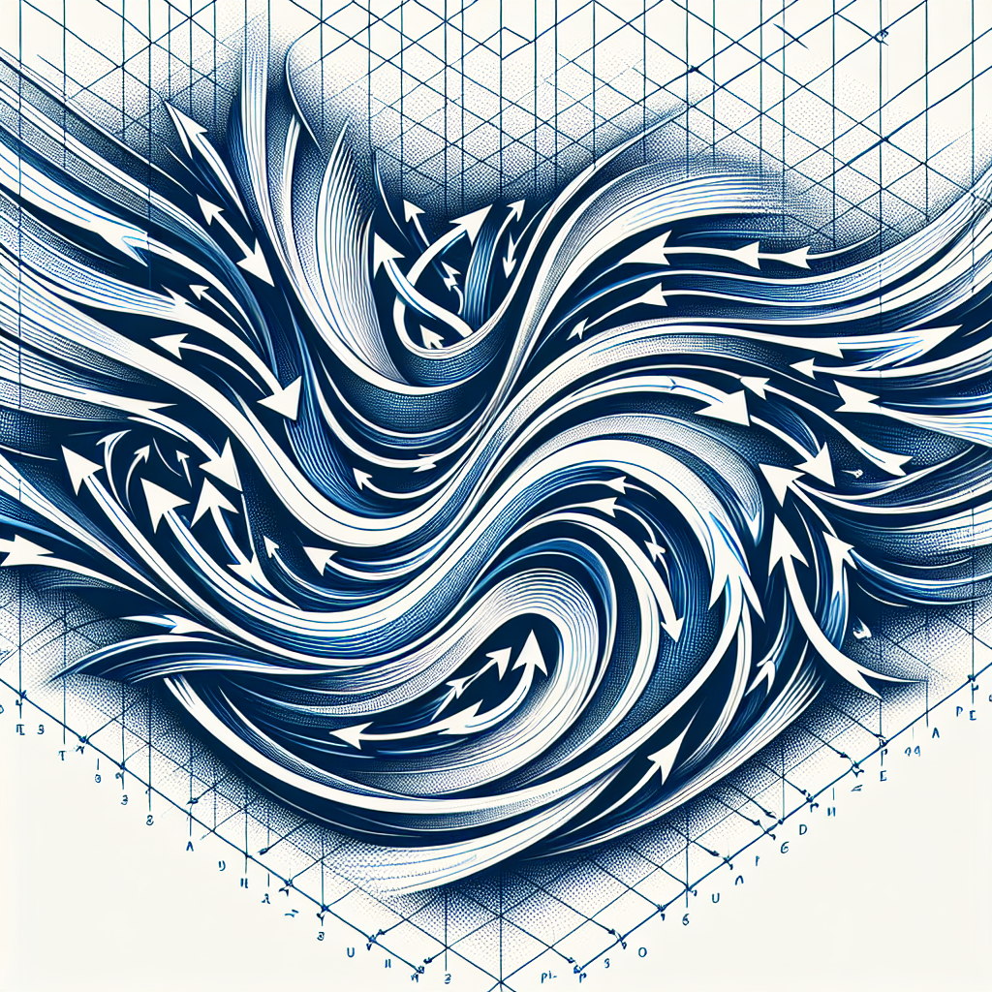
Vector Fields
Vector fields are used to model fluid flow, electromagnetic fields, and other phenomena where a vector quantity varies in space
Vector Fields in Nature

Slide 13
Lagrange Multipliers
Lagrange multipliers offer a strategy for finding local maxima and minima of functions subject to constraints
This method adds another layer of sophistication and utility in optimization problems involving several variables

Slide 14

Constrained Optimization
Constrained optimization problems are prevalent in real-world applications, requiring complex multivariable calculus techniques to solve efficiently
Solving Constrained Optimization

Slide 15
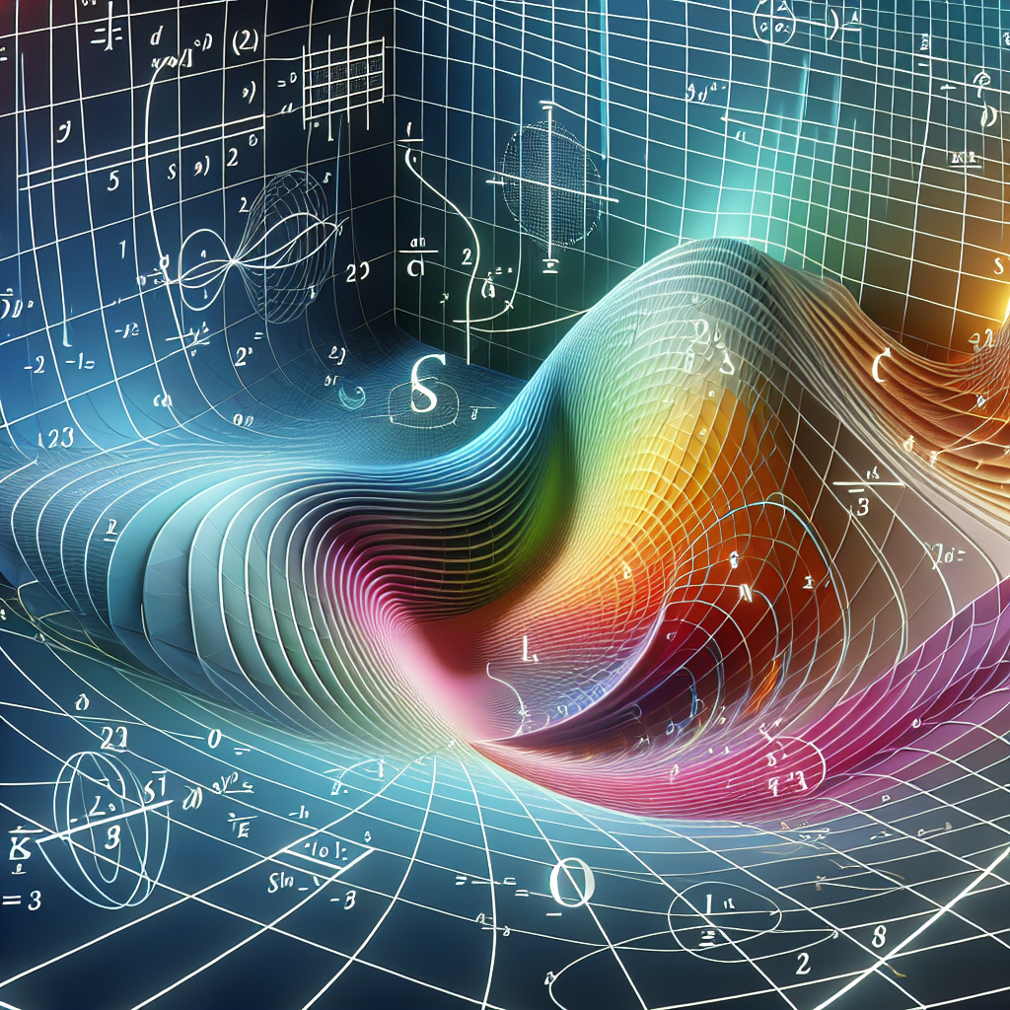
Curvilinear Coordinates
Moving beyond Cartesian coordinates, curvilinear coordinates like spherical and cylindrical systems are essential for solving problems in multidimensional spaces
Exploring Curvilinear Coordinates

Slide 16
Real-life Examples of Multivariable Calculus
From optimizing production in factories to predicting weather patterns, multivariable calculus has extensive applications across various fields
Its principles help us model and understand the complexity of the world around us

Slide 17

Challenges in Learning Multivariable Calculus
Despite its importance, the complexity and abstraction of multivariable calculus present significant learning challenges
Educational strategies involving visualizations and practical examples can facilitate understanding
Overcoming Learning Challenges

Slide 18
Advanced Topics in Multivariable Calculus
Diving deeper, topics like manifold theory and differential geometry extend the applications and understanding of multivariable calculus to new heights
These areas explore the calculus of curved spaces, contributing to advancements in physics and engineering

Slide 19
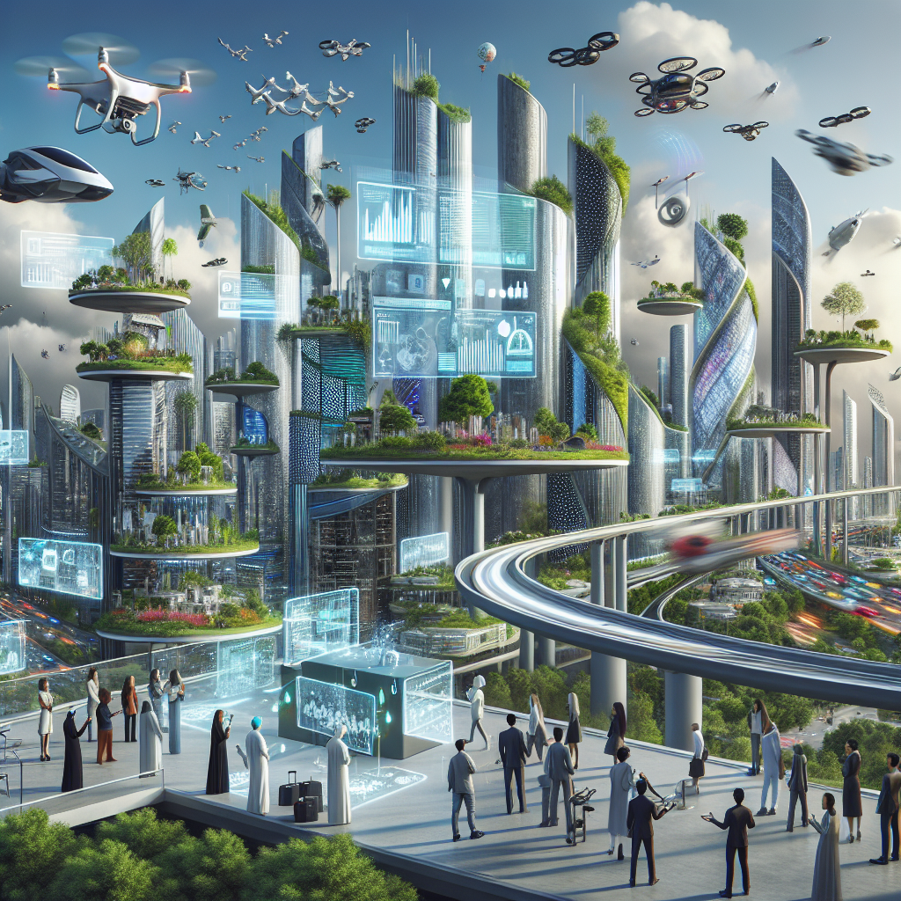
The Future of Multivariable Calculus
As mathematical practices evolve with technology, the future of multivariable calculus promises new methods and applications, aiding in the solution of increasingly complex problems
Evolving Practices and Theories

Slide 20
Conclusion
Multivariable calculus is a crucial field for advancing our understanding and capabilities in multiple dimensions
Its applications and concepts pave the way for innovations across a myriad of scientific disciplines

